Slide 1
The Role of Naturopathic Medicine in Cancer Care

Slide 2
Defining Integrative Oncology & Naturopathic Scope of Care
Patient Demand
AGENDA
Research
Goals of Naturopathic Medicine
Case Studies

Slide 3
Defining Integrative Oncology & Naturopathic Scope of Care

Slide 4
What is Integrative Oncology?
Integrative Oncology is a combination of conventional cancer treatment with natural and supportive therapies
Is a collaboration between multi-disciplinary health care providers to best support optimal health: physically, mentally and emotionally.
Surveys estimate that greater than 80% of people with cancer use natural medicine.
Richardson MA, Sanders T, Palmer JL, et al. Complementary/Alternative Medicine Use in a Comprehensive Cancer Center and the Implications for Oncology. J Clin Oncol 2000 Jul;18(13):2505-

Slide 5
Integrative Oncology Includes:
Naturopathic doctors (NDs) working with patients receiving conventional treatment for cancer.
NDs are trained in evidence-based modalities: counseling, mindfulness, nutrition, botanical medicine, exercise, and physical medicine.
Goals are to improve quality of life, manage side effects, enhance recovery from treatment, lower risk of recurrence, and provide healthy lifestyle education.

Slide 6
What is Naturopathic Medicine?
A distinct primary health care profession emphasizing education, prevention, treatment and optimal health of mind, body and spirit.
NDs provide evidence-informed natural and supportive therapies which complement standard of care medicine.
Therapeutic care varies by state and territory and may include acupuncture, botanical medicine, physical medicine, clinical nutrition, homeopathy, lifestyle counseling, intravenous therapies and/or prescription drugs.

Slide 7
Education and Training of Naturopathic Doctors
A Naturopathic medicine degree requires:
4 years pre-medical undergraduate studies.
4-5 years professional studies at federally recognized and regionally accredited Naturopathic Medical School.
Clinical training and Naturopathic Physicians Licensing examinations.
Post graduate residency programs available.
Doctoral degree confers Naturopathic Doctor or “ND” designation.
Notes:
Training includes:
Internships & clinical rotations
Residency & fellowship opportunities in subspecialties ex. FABNO
7 Schools in North America, 5 in US, 2 in Canada
ND’s in 19 states, the District of Columbia, and the United States territories of Puerto Rico and the United States Virgin Islands have licensing or regulation laws for Naturopathic doctors.- AANP
ND’s are registered in the provinces and northern territories

Slide 8
What is Naturopathic Oncology?
The Oncology Association of Naturopathic Physicians defines “Naturopathic oncology” as: the application of the art and science of Naturopathic medicine to the field of cancer care and treatment.
NDs trained in integrative oncology play an important role in the care of people with cancer to:
Advise on safe, effective use of natural and supportive therapies combined with conventional treatment.
Work collaboratively with other providers at all stages:
At time of diagnosis (to prepare for what lies ahead).
During active treatment (to manage side effects and address co-management of disease process through natural approaches).
Post-treatment (to help recovery and to support prevention of recurrence).

Slide 9
Advanced Training of Naturopathic Doctors in Oncology
Fellows of the American Board of Naturopathic Oncology (FABNOs) meet the highest standard of the profession. Requirements for board certification:
2-year residency focused in Naturopathic medicine in oncology within hospital based integrative care teams along with conventional providers
OR
Must be in practice for at least 5 years with 2400 oncology patient contact hours
Submit cases for review by designated examiners
AND
Must pass a board certification exam.
Awarded status of Fellow by the American Board of Naturopathic Oncology.

Slide 10
Naturopathic Medicine Provides Whole Person Care
Naturopathic medicine includes the following concepts:
State of health is inseparable from body, mind, spirit & environment.
The body has an inherent ability to heal itself.
Lifestyle factors contribute to health and illness.
Every individual is biochemically unique.
NDs take time to listen and engage with patients.
Patients are educated to take an active role in their healing process.
"Self-care” through lifestyle based interventions is encouraged.

Slide 11
What Happens in a Typical ND Visit
Initial consultation:
varies in length among practitioners and may be up to 90 minutes.
includes medical history, review of previous laboratory, pathology and imaging reports, and patient assessment. Indicated lab tests may be ordered.
Treatment plan: is personalized may consist of nutritional guidance, vitamin and herbs, and recommendations for therapeutic lifestyle changes
May include referrals to other providers.
Patients typically return for 30-60 minute follow-up sessions as needed.

Slide 12
What Happens in a Typical ND Visit (cont’d)
NDs answer questions about natural therapies, discuss patients’ goals and provide education about conventional and natural treatments.
Naturopathic consults include review and assessment of:
Key health parameters: inflammation, digestion, elimination, nutritional status, blood sugar control, stress, fitness, sleep, immune function, risk factors, mental emotional status, and disease status.
Current records: labs, imaging, surgical, radiation and medical oncology reports.
Prescription medications & supplements in use: to avoid possible interactions with any natural health product & ensure safety.

Slide 13
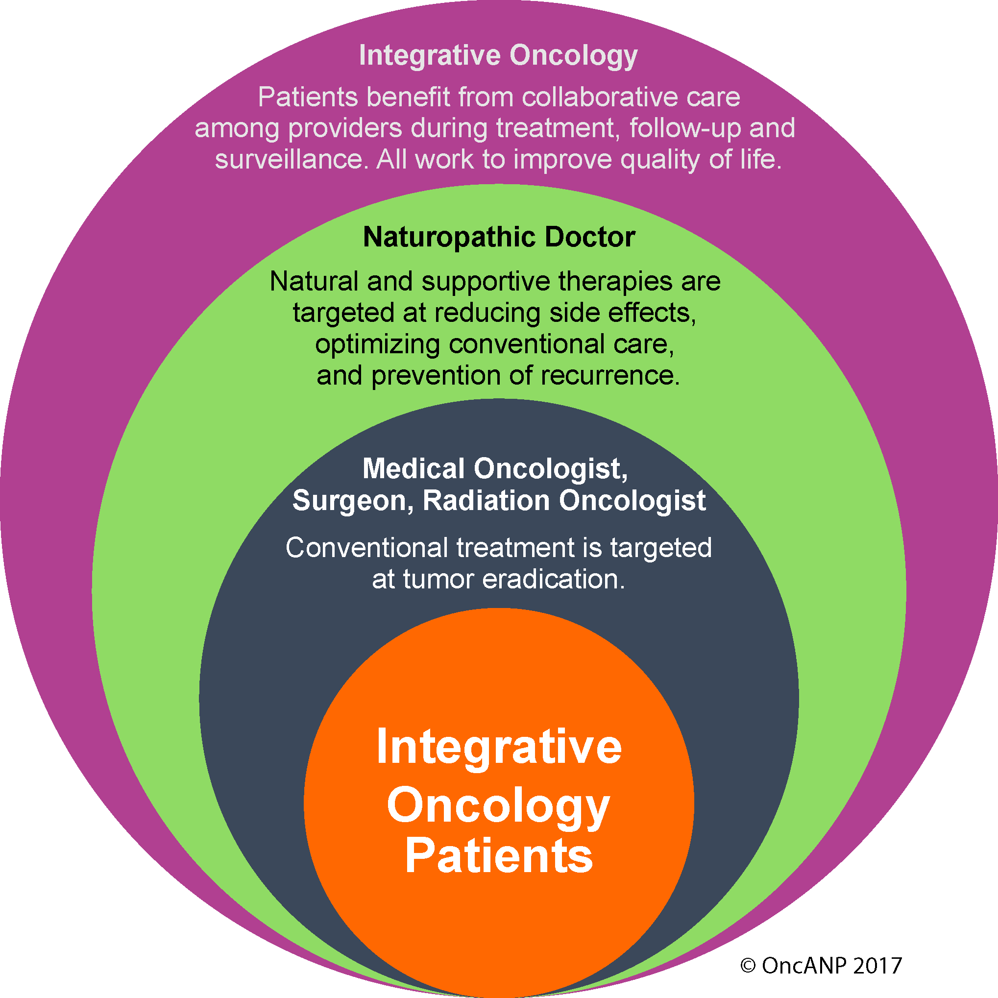
Collaboration Among Providers

Slide 14
Patient Demand: The Data

Slide 15
Cancer Patients Use of Natural Therapies – CDC Survey
Over half of the US population is using supplements.
11% of oncology patients report use of natural therapies prior to diagnosis.
58% report use of natural therapies after diagnosis.
52% of natural medicine consumers with cancer take dietary supplements.
41% of oncologists regularly ask their patients about supplement use.
Two thirds of oncologists said they avoid this topic due to lack of training.
Journal of Clinical Oncology, 2015 ASCO Annual Meeting (May 29 – June 2, 2015) Vol 33, No 15_suppl (May 20 Supplement), 2015: 9625. Link to CDC report: http://www.cdc.gov/nchs/data/databriefs/db61.htm

Slide 16
Cancer Patients Use Complementary Therapies
Survey of 453 patients on Complementary & Alternative Medicine (CAM) use.⁽¹⁾
83.3% used at least one CAM therapy concurrent with cancer treatment. ⁽¹⁾
40% had not discussed CAM usage with their physicians. ⁽¹⁾
24.7% used seven or more CAM therapies. ⁽¹⁾
41% of oncologists regularly ask their patients about supplement use. ⁽¹⁾
Survey of 3400 respondents, 87% use CAM during cancer care in comprehensive cancer care centre. ⁽²⁾
Richardson MA, Sanders T, Palmer JL, et al. Complementary/Alternative Medicine Use in a Comprehensive Cancer Center and the Implications for Oncology. J Clin Oncol 2000 Jul;18(13):2505-1
Patricia L. Judson, MD, Reem Abdallah, MD, et al. Complementary and Alternative Medicine Use in Individuals Presenting for Care at a Comprehensive Cancer Center. Integrative Cancer Therapies 2017, Vol. 16(1) 96–103

Slide 17
Attitudes & Practice Patterns of Oncologists – 2014 Survey
Oncologists discuss use of supplements with 41% of patients.
26% of discussions initiated by the oncologist.
Two out of three oncologists reported they did not have enough knowledge to answer questions regarding herbs and supplements.
59% had not received any education about the topic.
Lee RT, Barbo A, Lopez G, Melhem-Bertrandt A, Lin H, Olopade O, Curlin FA. National Survey of US Oncologists' Knowledge, Attitudes, and Practice Patterns Regarding Herb and Supplement Use by Patients With Cancer. J Clin Oncolo 2014 Nov 17 pii: JCO.2014.55.8676

Slide 18
Research

Slide 19
The Current State of Integrative Oncology Research
Research in integrative oncology research is substantial and ever-growing.
Largely guided by single intervention RCTs.
NDs focus on the highest quality human data for clinical decision-making.
Many studies show safety of natural therapies in humans with support for improvement in: quality of life, side-effects, treatment response and survival.
Notes:
Misconceptions about Research
Common misconception is that complementary medicine is not evidence-based.
Over several decades there has been exponential growth in science and clinical research.
Integrative oncology is supported by evidence and most importantly, by very real benefits achieved by those living with cancer.
Research Limitations and Opportunities
Available research funding is limited by non-patentable nature, and the more prevalent (pharmaceutical?) agenda of treatment of disease rather than prevention.
Most research is done on single agents for specific clinical questions.
Reality is that practice, particularly Naturopathic, is not monotherapeutic but holistic.
Need more observational research and pragmatic, real world clinical trials.
Need whole systems practice research to evaluate real world application of Naturopathic oncology.

Slide 20
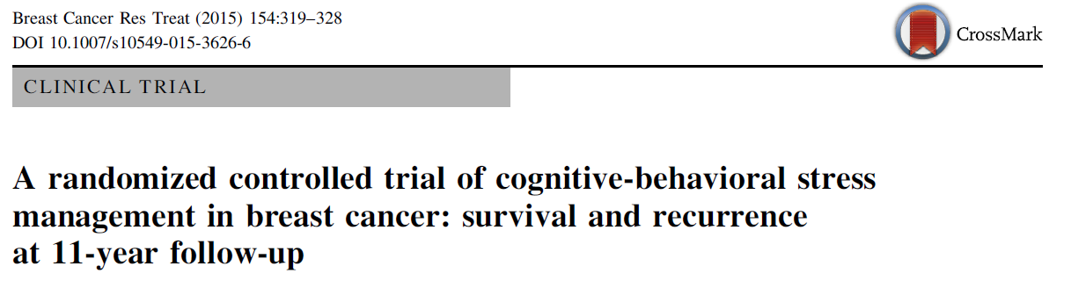
Research Example: Mental-Emotional Support
Survival & Recurrence after 11 years.
Participants in the stress reduction program had a 79% lower risk of dying from any cause (p=0.04) and a 55% lower risk of having a breast cancer recurrence (p=0.01).
Stress management program
(CBSM); 10 weeks
Breast cancer patients post surgery
(N= 240)
Control
1 day seminar
Notes:
Additional Anxiety support: Kasper S, Gastpar M, Muller WE, et al. Lavender oil preparation Silexan is effective in generalized anxiety disorder. A randomized, double-blind comparison to placebo and paroxetine. Int J Neuropsychopharmacol. 2014; 17(6): 859-69.

Slide 21
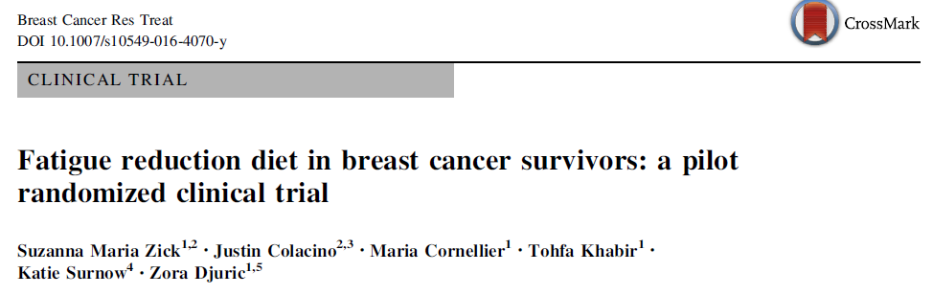
Research Example: Fatigue Support
Followed for 3 months.
Fatigue improved by 44% in FRD group compared to 8% in control (p= 0.01).
Sleep quality improved by nearly 50% in FDR group, with no improvement in control (p=0.03).
Fatigue reduction diet (n=15):
Fruits, vegetables, whole grains, omega-3 rich foods
30 stage 0-III breast cancer survivors
General Health Curriculum Control (n=15)
Notes:
Nutrition improving QoL by reducing fatigue
Diet is very much in line with Mediterranean diet
Rationale for including this: There is LOTS of research on nutrition for decreasing risk of disease (including cancer, CVD, diabetes, obesity, etc), but this is interesting as it shows how Nutrition also impacts QOL AND can make a difference with a short-term intervention.
Fatigue-reduction diet focused on fruit, vegetables, whole grains, omega-3 fatty acid-rich foods.
Both groups received in-person sessions at baseline and 3 months, and 6x15 minute phone counseling sessions weekly for the first 4 weeks, then biweekly. The General health curriculum was therefore an attention-matched control, had same time but discussed general health topics, not just nutrition (ex: oral health, colorectal cancer screening, etc)
Fatigue-reduction diet:
(1) At least half of grain intake from whole grains; (2) five servings of vegetables (one leafy green, one tomato, and one yellow or orange); (3) two servings of fruit (one high in vitamin C); (4) one serving of fatty fish and (5) one serving of omega-3 fatty acid-rich nuts, seeds, or their associated oils (two servings of nuts or seeds for vegetarians).
The counseling for this diet used participant daily self-monitoring checklists to help participants achieve goal intakes for the target foods.
Breast Cancer Res Treat. 2016 Dec 2. [Epub ahead of print]
Fatigue reduction diet in breast cancer survivors: a pilot randomized clinical trial.
Zick SM^{1,2}, Colacino J^{3,4}, Cornellier M⁵, Khabir T⁵, Surnow K⁶, Djuric Z^{5,7}.

Slide 22
Research Example: Ganoderma (Reishi) for Fatigue
Randomized control trial with 48 patients with existing fatigue, receiving endocrine therapy for breast cancer; Stage 1 – IIIA.
Ganoderma mushroom spore powder 1000 mg TID, or placebo, for 4 weeks.
FACT-F, Hospital Anxiety and Depression Scale (HADS), EORTC quality of life - (QLQ-C30) at baseline and 4 weeks.
TNF-alpha, IL-6, liver, kidney function at baseline and 4 weeks.
Results of statistical significance in the study:
Ganoderma (Reishi) decreased the concentrations of TNF-α and IL-6.
Fatigue improved and subjects had better physical well being (p<0.05) and emotional function scores (p<0.05).
Anxiety, depression, and sleep improved (p<0.01).
Improved emotional and cognitive function.
Improved physical function and global QOL.
Zhoa H et al. Spore Powder of Ganoderma lucidum Improves Cancer-Related Fatigue in Breast Cancer Patients Undergoing Endocrine Therapy: A Pilot Clinical Trial. Evid Based Complement Alternat Med. 2012;2012:809614

Slide 23
Research Example: Exercise for Fatigue
Systematic review and meta-analysis to determine effect of supervised exercise on cancer-related fatigue (CRF) in breast cancer survivors.
9 studies included, N=1156, randomized trials without restrictions on stage of disease.
67% or 6 studies were conducted during active treatment i.e. chemotherapy and radiotherapy.
Aerobic training was described in all studies, 6 studies included resistance training, stretching exercises in 1 study.
Supervised exercise had a mean length of 21.4 weeks (SD of 15.8 weeks).
Mean duration: 44.3 minutes (SD 15.2) with average 2.5 sessions per week.
Results of statistical significance in the study:
Pooled analysis reports supervised aerobic exercise was statistically more effective than conventional care in improving CRF in breast cancer survivors. (SMD = -.51, 95% CI -0.81 to -0.21) with statistical heterogeneity, P = 0.001).
Supervised exercise during treatment showed significant benefit in CRF. (SMD = -0.66, 95% CI -1.08 to -0.23) P = 0.002.
Resistance training significantly improved CRF (SMD = -0.55; 95% CI, -1.09 t0 -0.01).
Meneses-Echávez JF, González-Jiménez E, Ramírez-Vélez R. Effects of supervised exercise on cancer-related fatigue in breast cancer survivors: a systematic review and meta-analysis. BMC Cancer. 2015;15:77. doi:10.1186/s12885-015-1069-4.

Slide 24
Additional Research Examples: Side-Effect management
Fish oil for prevention of neuropathy: 1.2 g fish oil daily was protective comparative to placebo for incidence of neuropathy in breast cancer patients receiving treatment with paclitaxel chemotherapy (p=0.029) – Ghoreishi et al. BMC Cancer. 2012; 12:355
Berberine to prevent pelvic radiation induced diarrhea: pre-treatment with berberine 300 mg three times daily significantly reduced the incidence and severity of radiation-induced acute intestinal syndrome (RIAIS) and postponed onset in cancer (p<0.05). – Li GH et al. Med Oncol. 2010; 27(3):919-25
Zinc carnosine to support mucositis: zinc carnosine is associated with reduction in mucositis, pain, xerostomia and dysgeusia in head and neck cancer patients receiving chemo-radiation and did not alter response rate. Patients taking zinc used less analgesics (p=0.003) and had higher food intake (p=0.002) than controls. – Watanabe et. Al. Cancer. 2010l 127(8): 1984-90

Slide 25
Research Example: Optimizing Conventional Treatment
Melatonin
A systematic review and meta-analysis reports patients taking 20mg melatonin before bed nightly had statistically significant improvement for complete response, partial response and stable disease with RRs of 2.33 (95% CI = 1.29-4.20), 1.90 (1.43-2.51), and 1.51 (1.08-2.12)
Melatonin use decreased one-year mortality (RR = 0.60; 95% CI = 0.54-0.67).
Improvements in side effects: asthenia, leukopenia, nausea, vomiting, hypotension and thrombocytopenia were also reported. - Seely D, Wu P, Fritz H, et al. Melatonin as adjuvant cancer care with and without chemotherapy: a systematic review and meta-analysis of randomized trials. Integr Cancer Ther. 2012; 11(4): 293-303.
Fish oil
1.8 g DHA daily from fish oil supplement significantly improved outcomes in metastatic breast cancer patients undergoing treatment with chemotherapy.
- Bougnoux et al. British Journal of Cancer. 2009; 101:1978-1985

Slide 26
Goals of Naturopathic Medicine

Slide 27
Goals of Naturopathic Approach to Care
Guide safe use of natural and supportive therapies
Support optimal health and wellbeing during cancer treatment
Reduce or prevent cancer treatment-related side effects
Patient education and advocacy
Patient safety:
Avoid drug/nutrient interactions to prevent under- or over-exposure to chemotherapy, radiotherapy or targeted agents
Assess for supplement quality
Advise on safe dosage
Communicate with medical providers regarding use of natural therapies
Potentially augment effects of conventional oncology care

Slide 28
Support for Symptom Management & Chronic Conditions
NDs provide support for side effects, common symptoms and chronic conditions patients experience during cancer treatment.
Cancer treatment side effects:
Fatigue, Pain, Mucositis, Nausea and Vomiting, Diarrhea or Constipation, Dermatitis, Peripheral Neuropathy
Common chronic conditions:
Allergies, Anxiety, Autoimmune Conditions, Depression, Diabetes, Fatigue, Hypertension, Hyperlipidemia, Insomnia, Osteoarthritis, Pre-Postmenopausal Symptoms, Reflux Esophagitis

Slide 29
Example of Breast Cancer Symptom Management: FATIGUE
NDs answer patient questions about supplements and adjunctive therapies
Evidence-based recommendations that may be used to support reduction of fatigue include:
Ganoderma 1000 mg tid.
Ginseng 1000 mg daily.
Exercise - Yoga 90 minutes 2x per week or 2-3 sessions supervised exercise weekly.
Vitamin D3 test blood level and supplement with goal to normalize level.
Nutrition – Fruits, vegetables, whole grains, omega-3 rich foods.
Notes:
Ganoderma:
Zhoa H et al. Spore Powder of Ganoderma lucidum Improves Cancer-Related Fatigue in Breast Cancer
Patients Undergoing Endocrine Therapy: A Pilot Clinical Trial. Evid Based Complement Alternat Med.
2012;2012:809614
Ginseng:
Barton DL, Liu H, Dakhil SR, et al. Wisconsin Ginseng (Panax quinquefolius) to Improve Cancer-
Related Fatigue: A Randomized, Double-Blind Trial, N07C2. JNCI Journal of the National Cancer
Institute. 2013;105(16):1230-1238. doi:10.1093/jnci/djt181.
Exercise:
Kiecolt-Glaser JK, Bennett JM, Andridge R, et al. Yoga’s impact on inflammation, mood, and fatigue in
breast cancer survivors: a randomized controlled trial. J Clin Oncol. 2014;32(10):1040-1049.
doi:10.1200/JCO.2013.51.8860.
Meneses-Echávez JF, González-Jiménez E, Ramírez-Vélez R. Effects of supervised exercise on
cancer-related fatigue in breast cancer survivors: a systematic review and meta-analysis. BMC
Cancer. 2015;15:77. doi:10.1186/s12885-015-1069-4.
Kampshoff CS, Chinapaw MJM, Brug J, et al. Randomized controlled trial of the effects of high
intensity and low-to-moderate intensity exercise on physical fitness and fatigue in cancer
survivors: results of the Resistance and Endurance exercise After ChemoTherapy (REACT)
study. BMC Medicine. 2015;13:275. doi:10.1186/s12916-015-0513-2.
Vitamin D:
Roy S, Sherman A, Monari-Sparks MJ, Schweiker O, Hunter K. Correction of Low Vitamin D
Improves Fatigue: Effect of Correction of Low Vitamin D in Fatigue Study (EViDiF Study). North
American Journal of Medical Sciences. 2014;6(8):396-402. doi:10.4103/1947-2714.139291.
Trivanovic D, Plestina S, Dobrilla-Dintinjana R, Honovic L, Jerin L, Hrstic I. Vitamin D3 supplementation to improve fatigue in patients with advanced cancer. J Clin Oncol. 2012;30(15_suppl):9097. doi:10.1200/jco.2012.30.15_suppl.9097.
Alfano CM, Imayama I, Neuhouser ML, et al. Fatigue, inflammation, and-γ3 and γ-6 fatty acid intake among breast cancer survivors. J Clin Oncol. 2012;30(12):1280-1287. doi:10.1200/JCO.2011.36.4109.

Slide 30
Case Studies
Please note: the following slides present actual cases however the names have been changed to protect privacy.

Slide 31
Case Example #1 – Danielle
Danielle’s Diagnosis: Danielle is a 44 y.o. Caucasian woman diagnosed with Stage IIb invasive ductal carcinoma. Her left sided tumor was 5.5 cm, grade 2, ER+, PR+, HER2/neu-, and 0LN. Oncotype Dx risk of recurrence score = 42. TNM Breast Cancer Staging: T3pN0M0. T3=Tumor size >5cm, N0 = no cancer in lymph nodes found, M0 = no metastasis.
Conventional Treatment: Danielle completed a mastectomy & chemotherapy with dose dense Adriamycin (doxorubicin) & Cytoxan (cyclophosphamide) followed by Taxotere (docetaxel). She then began six weeks of radiation and afterward, Tamoxifen.
Problem List: (1) insomnia with trouble staying asleep (2) mild anxiety & depression 3/10 (10 most anxious and sad) (3) fatigue 6/10 (10 most fatigue) (4) wants to use natural medicine to prevent side effects of cancer treatment (5) wants best survival possible.

Slide 32
Case #1 – Naturopathic Approach for Danielle
Review treatment records, blood work: Vitamin D blood test recommended.
Lifestyle/behavioural recommendations:
Washing with gentle soap and water daily to attend radiation with clean dry skin. (1)
Review sleep hygiene, recommend 8 hours sleep; educate about effect of steroid pre-meds on sleep. (2)
Cardiovascular exercise and regular physical activity recommendations provided. (3,4,5)
Nutritional counselling: 7-10 fruits and vegetables daily; promote whole foods plant-based diet; create goals for weight reduction via reduced carbohydrate intake & increased physical activity. (4)
Evidence based supplements:
Melatonin 20 mg (6,7) , Co Q 10 100mg (8) , Ganoderma 1000mg. (9)
Notes:
1. A.Lloyd,Bolderston. The prevention and management of acute skin reactions related to radiation therapy: A systematic review and practice guideline. Supportive Care in Cancer. 2006;14(8): 802-17.
2. McCurry SM, Guthrie KA, Morin CM, Woods NF, Landis CA, Ensrud KE5, Larson JC, Joffe H, Cohen LS, Hunt JR, Newton KM, Otte JL, Reed SD, Sternfeld B, Tinker LF, LaCroix AZ. Telephone-Based Cognitive Behavioral Therapy for Insomnia in Perimenopausal and Postmenopausal Women With Vasomotor Symptoms: A
MsFLASH Randomized Clinical Trial. JAMA Intern Med. 2016 Jul 1;176(7):913-20.
3. de Glas NA, Fontein DB, Bastiaannet E, Pijpe A, De Craen AJ, Liefers GJ, Nortier HJ, de Haes HJ, van de Velde CJ, van Leeuwen FE. Physical activity and survival of postmenopausal, hormone receptor-positive breast cancer patients: results of the Tamoxifen Exemestane Adjuvant Multicenter Lifestyle study. Cancer. 2014 Sep 15;120(18):2847-54.
4.Irwin ML, Smith AW, McTiernan A, et al. Influence of pre- and postdiagnosis physical activity on mortality in breast cancer survivors: the health, eating, activity, and lifestyle study. J Clin Oncol. 2008;26(24):3958-3964.
doi:10.1200/JCO.2007.15.9822.
5. Borch KB, Braaten T, Lund E, Weiderpass E. Physical activity before and after breast cancer diagnosis and survival - the Norwegian women and cancer cohort study. BMC Cancer. 2015;15:967. doi:10.1186/s12885-015-1971-9.
6. Mills E, Wu P, Seely D, Guyatt G. Melatonin in the treatment of cancer: a systematic review of randomized controlled trials and meta-analysis. J Pineal Res. 2005;39:360–366.
7. Hansen MV, Andersen LT, Madsen MT, Hageman I, Rasmussen LS, Bokmand S, Rosenberg J, Gögenur I. Effect of melatonin on depressive symptoms and anxiety in patients undergoing breast cancer surgery: a randomized, double-blind, placebo-controlled trial. Breast Cancer Res Treat. 2014 Jun;145(3):683-95. doi:
10.1007/s10549-014-2962-2.
8. References for CoQ10: Srinivasan,Yuvaraj, Vummidi Gridhar, Premkumar,Palanivel, Shanthi,Kothandaraman, Vijayasarathy, Sitthu Govindaswamy Dinakaran, Gangadaran, Panchanatham,Sachdanandam. Effect of Coenzyme Q10, Riboflavin and Niacin on tamoxifen treated postmenopausal breast cancer women with special reference to blood chemistry profiles. Breast Cancer Research and Treatment. 2009;114(2):377-384.
9. References for ganoderma: Zhoa H et al. Spore Powder of Ganoderma lucidum Improves Cancer-Related Fatigue in Breast Cancer Patients Undergoing Endocrine Therapy: A Pilot Clinical Trial. Evid Based Complement Alternat Med. 2012;2012:809614

Slide 33
Case #1: At 2 months – Danielle is Active in Self Care
Vitamin D level: 21 (low), recommend 5,000 IU vitamin D3 daily taken with meal with repeat blood work to check blood calcium level in 3 weeks and repeat vitamin D blood level at 3 months.
Insomnia resolved. Danielle reports behavior change made to get 8 hours of sleep vs. 5-6; states sleep improved with melatonin; wakes feeling more rested.
Intended weight loss via exercise & healthy diet. Danielle reports utilizing cardiovascular exercise and dietary recommendations with overall weight loss of 5 pounds 2 months after follow-up.
Danielle is referred to nutritionist to continue progress on dietary goals tailored to her lifestyle and family.
Energy level improved. Fatigue reported to be 1-2/10 (10 most fatigue).
Anxiety reduced. Danielle reports feeling relieved having a prevention plan in place and with taking control of her health with exercise and nutrition.

Slide 34
Case Example #2 – Robert
Robert’s Diagnosis: This is a 61 year old Hispanic male computer programmer with a history of testicular cancer at age 35 which was treated with radiation to the pelvis. Currently diagnosed with bladder cancer after three months of hematuria. Patient reports taking supplements: melatonin, D3, fish oil, probiotics.
Conventional Treatment: Surgery was planned after two cycles of preoperative gemcitabine plus cisplatin chemotherapy. However the patient refused surgery. Therefore chemotherapy was begun. He has had two cycles of Cisplatin chemotherapy and requests expertise on natural therapies to support his health during oncology care due to onset of neuropathy.
Problem List: (1) Dose limiting neurotoxicity from Cisplatin in 2nd cycle (2) CTCAE grade 2-3 peripheral sensory neuropathy in the fingers that limits ADL’s (3) Patient and oncologist discuss treatment break or potential discontinuation. Patient wants to continue work as computer programmer with use of hands (4) Patient asks if a natural therapy could support reduction in neuropathy.

Slide 35
Case #2 – Naturopathic Approach for Robert
Naturopathic Recommendations:
Oral vitamin E (mixed natural tocopherols) 300 mg twice daily.
Advise Robert on safe supplementation with fish oil, D3, probiotics, and melatonin.
Educate on adequate hydration, provide nutrition advice for whole foods/plant based diet.
Communicate with oncologist about recommendations made for Robert.
Outcome:
Robert reports complete resolution of neuropathy within six days of beginning vitamin E and continues next cycle of chemotherapy.
Robert continued four more cycles of chemotherapy without delay or interruption.
Notes:
Fish oil:
Janet M., Schloss, Maree, Colosimo, Caroline, Airey, Paul P., Masci, Anthony W., Linnane, Luis, Vitetta. Nutraceuticals and chemotherapy induced peripheral neuropathy (CIPN): A systematic review. Clinical Nutrition. 2013;32(6).
Vitamin E:
Argyriou,E, Chroni,A, Koutras,J, Ellul,S, Papapetropoulos,G, Katsoulas,G, Iconomou, HP, Kalofonos. Vitamin E for prophylaxis against chemotherapy-induced neuropathy: a randomized controlled trial.
Neurology. 2005;64(1).
Pace. Neuroprotective Effect of Vitamin E Supplementation in Patients Treated With cisplatin Chemotherapy. Journal of Clinical Oncology.2003; 21(5).
Argyriou,E,Chroni,A,Koutras,J,Ellul,S,Papapetropoulos,G,Katsoulas,G,Iconomou,H P,Kalofonos. Vitamin E for prophylaxis against chemotherapy-induced neuropathy: a randomized controlled trial. Neurology.
2005;64(1).
Argyriou AA, Chroni E, Koutras A, Iconomou G, Papapetropoulos S, Polychronopoulos P, Kalofonos HP. A randomized controlled trial evaluating the efficacy and safety of vitamin E supplementation for protection against cisplatin-induced peripheral neuropathy: final results. Support Care Cancer. 2006 Nov;14(11):1134-40.

Slide 36
Case Example #3 – Grace
Grace’s Diagnosis: This is a 68 year old African American woman with metastatic breast cancer who became dissatisfied with treatment at a leading academic cancer treatment institution and who sought an integrative approach with communication among her providers.
Conventional Treatment: Completed four cycles of Taxotere and Cytoxan. Currently treating with 2nd line carboplatin and gemcitabine and due to begin 3rd cycle.
Problem List: (1) nausea (2) headaches & constipation with beginning use of Zofran (ondansetron hydrochloride) (3) wants to try natural medicine approach.

Slide 37
Case #3 – Naturopathic Approach for Grace
Naturopathic Approach:
Answer Grace’s questions about natural therapies in supportive care that are safe and won’t interfere with her current chemotherapy treatment.
Oral Zingiber (Ginger) capsules 200mg tid (1).
Communicate with medical oncologist about recommendation for ginger and brief reference to relevant human level data.
Outcome:
At three week follow up, Grace reports nausea is controlled and only had to use Zofran 3 times in 3 weeks vs. daily.
Grace says she prefers ginger because her headaches and constipation resolved with much less use of Zofran.
Grace is pleased to be in an integrative treatment setting where Naturopathic doctor and oncologist co-manage her care.
(1) Ryan JL, Heckler CE, Roscoe JA, et al. Ginger (Zingiber officinale) reduces acute chemotherapy-induced nausea: a URCC CCOP study of 576 patients. Support Care Cancer. 2012;20(7):1479-1489. doi:10.1007/s00520-011-1236-3.
Notes:
Case #3 details re: Ginger & chemotherapy-induced nausea
Local patient treating at an academic medical institution came to the clinic because she was not
satisfied with the management of her side effects of treatment for her metastatic breast cancer. She
was interested in an integrative approach to assist with her side effects. She had completed 4 cycles
of Taxotere and Cytoxan. She was to receive cycle 3 of carboplatin and gemcitabine and expressed
that she was having a hard time with nausea. She was using Zofran but it gave her a headache and
constipation. The headaches were debilitating and severely effecting her quality of life. To address
her nausea she was recommended 200 mg of ginger tid which is the lower end of where the RCT
published by Ryan et al. indicated the most benefit. 2 The study by Ryan et al indicated the most
benefit with dosing between .5 – 1g per day. On the patients 3 week return she reported that her
nausea was controlled and that she only had to use Zofran 3 times in 3 weeks. She preferred the
ginger because her headaches and constipation resolved with only having to use the Zofran 3 times.

Slide 38
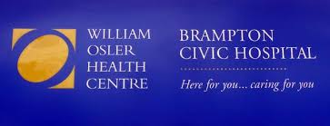
Naturopathic Doctors in Hospital Settings

Slide 39
Conclusion

Slide 40
The Impact of Naturopathic Medicine in Integrative Oncology
The majority of oncology patients today choose to use natural and supportive therapies alongside conventional treatments.
Therapies are non-invasive, evidence based, and often without side effects.
NDs trained in integrative cancer care offer expertise for patients and providers to:
Reduce side effects and support best possible outcomes.
Improve health and well-being before, during and after treatment.
Help prevent recurrence with healthy lifestyle education.
Naturopathic doctors help educate patients about standard of care oncology treatment and reinforce it’s importance.
Allows for coordination of care among providers and a higher standard of patient safety with physician experts qualified in the use of natural therapies to guide care.

Slide 41
The Impact of Naturopathic Medicine in Integrative Oncology
Combining Naturopathic and Conventional Medicine, supports the pursuit of best possible outcomes for patients.
Find a Naturopathic Doctor trained in integrative cancer care by State or Province: www.oncanp.org
Arrange a talk for your group or organization by a Naturopathic expert in oncology care: Contact OncANP Executive Director, Corey Murphy, at oncanp@gmail.com

